Slide 1
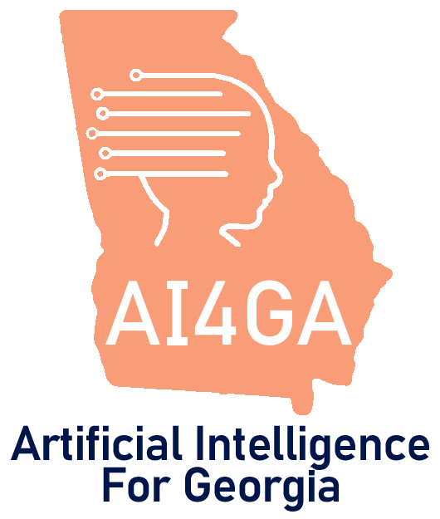
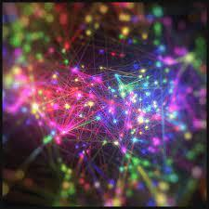

Module 3.4
Machine Learning with Datasets
Living and Working with Artificial Intelligence
Developed for the AI4GA (Artificial Intelligence for Georgia) project funded by National Science Foundation awards DRL-2049029 and DRL-2048502.
This work is licensed under the Creative Commons. Attribution-NonCommercial-ShareAlike 4.0 International License. https://creativecommons.org/licenses/by-nc-sa/4.0/

Slide 2
Learning Objectives
Students should be able to:
Use AI Lab to explore a dataset.
Train a classifier or predictor using AI Lab.
Measure the performance of a classifier or predictor on a test set.
Explain why running the same experiment in AI Lab multiple times may produce different results.

Slide 3
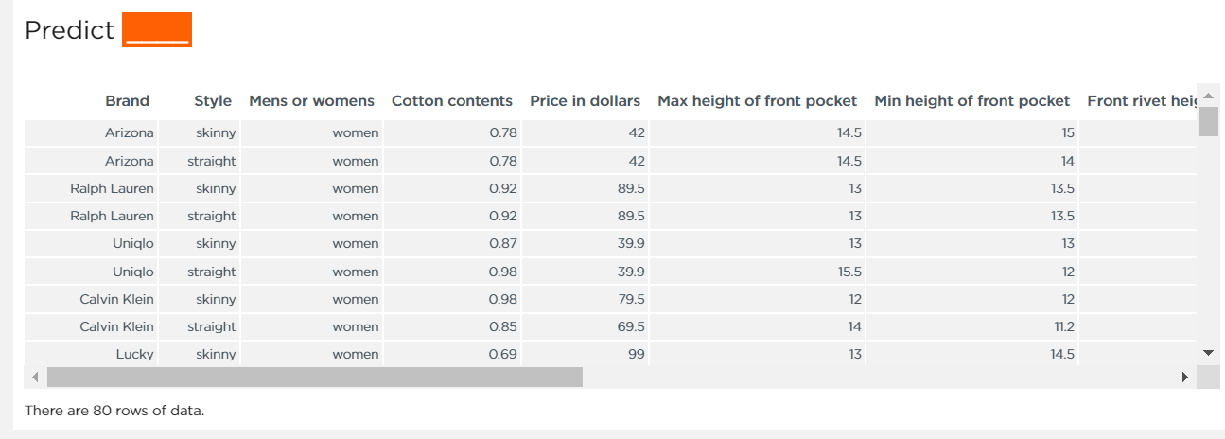
What are datasets?
a collection of data. In the case of tabular data, a dataset corresponds to one or more tables, where every column of a table represents a particular feature, and each row corresponds to an example of the dataset.
Jeans dataset from AI Lab.

Slide 4
Where do datasets come from?
Fun fact: Data is plural.
In Latin, data is the plural of datum. In specialized scientific fields, it is also treated as a plural in English. Therefore, we say data were collected and classified and not data was collected and classified
Phenomenon (singular),
An observable fact or event that occurs in a natural or designed system, especially one whose cause or explanation is in question. Phenomena (plural)
Scientists, companies, engineers, and data scientist
collect data about phenomena and problems they are interested in understanding
For, example data can come from
Sensors in a car
Surveys
Video or images of engaged animals or plants
Number of products, sneakers, or songs sold
Data can come from almost anywhere and take any form.

Slide 5

Orientation to AI Lab
& Its ML Pipeline
Use this link to access AI Lab
Notes:
Teacher note: Use slides and demo. Students can follow along in AI lab if they want as well. Then they can tinker with it on their own.

Slide 6
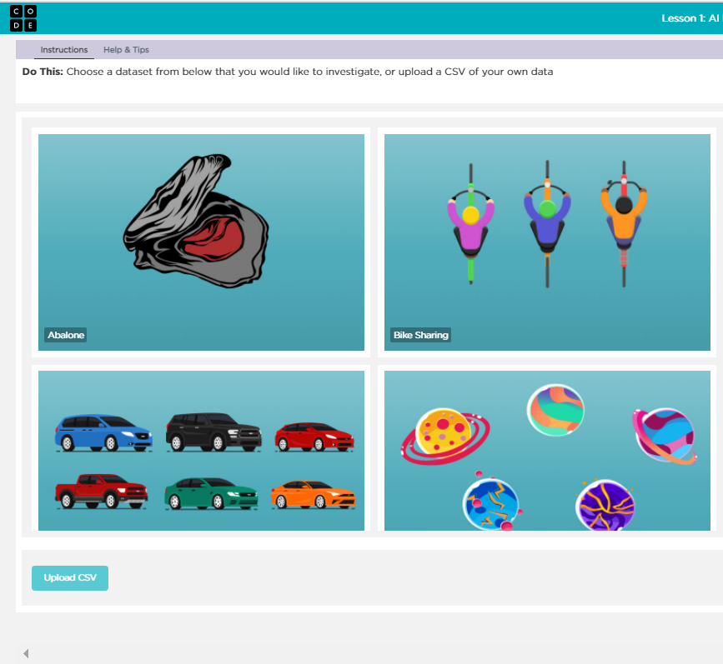
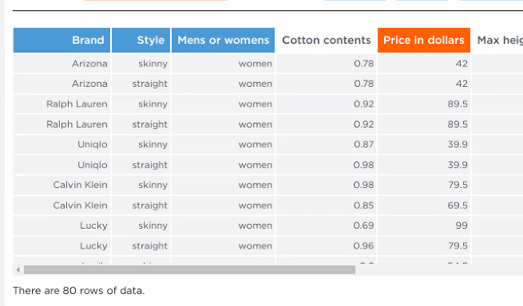
The AI Lab Machine Learning Pipeline
Men’s or Women’s
Style
Brand
Cotton content
Size of pockets
What features best predict the price of jeans?
Price of Jeans
Identify a dataset & review features
Identify a question
Select feature to predict
Select features that affect the feature to be predicted
Train a classifier
If accuracy low
Use the model in a system
Test the model
Review Accuracy
Notes:
Teacher Note: This pipeline has a lot of similarities to the one we use for machine learning for kids. But it has several differences.
Step 1 - We don’t need to collect our own data because we have a datasets that others have already created for us. When we look at this data set we can see that there are already a number of features identified in the columns and the rows of the table are filled with examples.
Step 2 - So instead of defining features, we have to identify a question we want to answer with our data
Step 3- then we will select the feature we want to predict
Step 4 - then we will select the features we think will help us predict the feature we selected

Slide 7
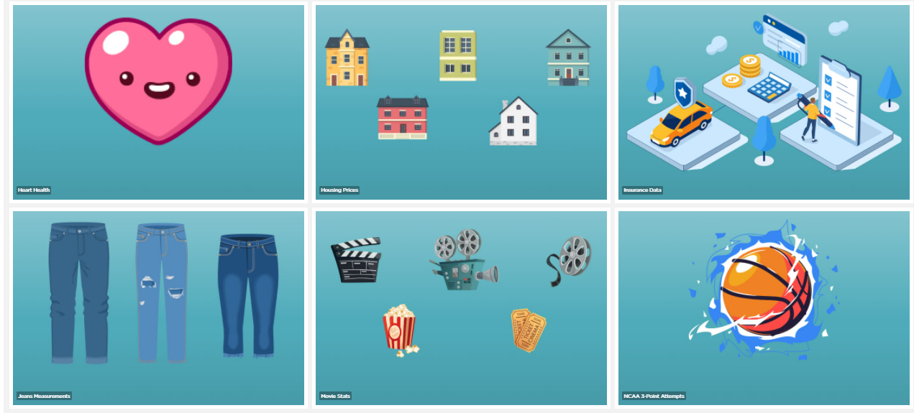
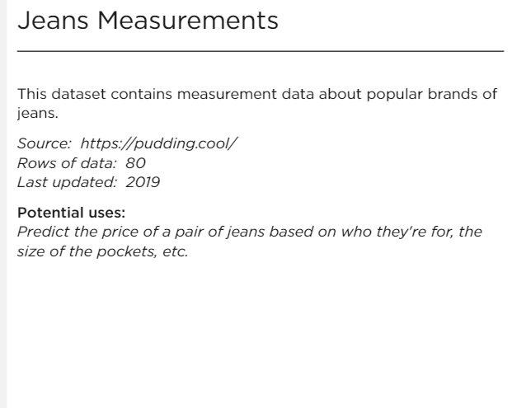
Step 1: Selecting a Dataset
AI Lab has a lot of different datasets to choose from that have already been preloaded into the tool. For our practice activity, select the Jeans Measurements dataset.

Slide 8
Identifying a Question
After we identify our dataset, we need to review its features to figure out what questions we can answer with it.
Jeans dataset from AI Lab.

Slide 9
What features best predict the price of jeans?
Our QUESTION:

Slide 10
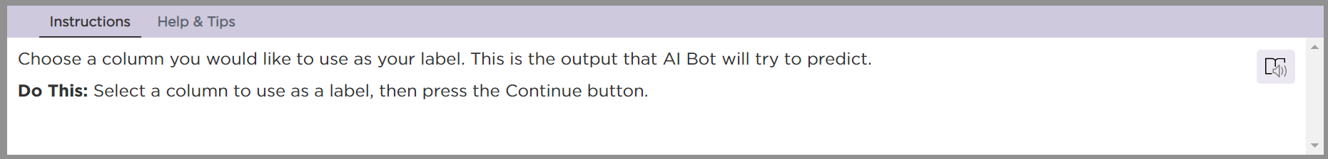
Selecting a feature we would like to predict

Slide 11
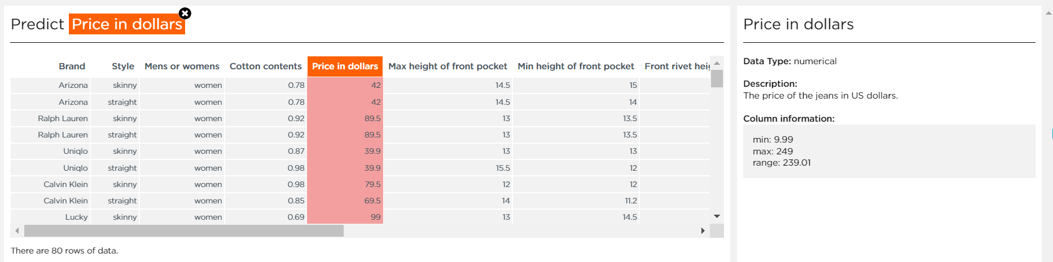
Label of the Feature we want to predict: price in dollars

Slide 12
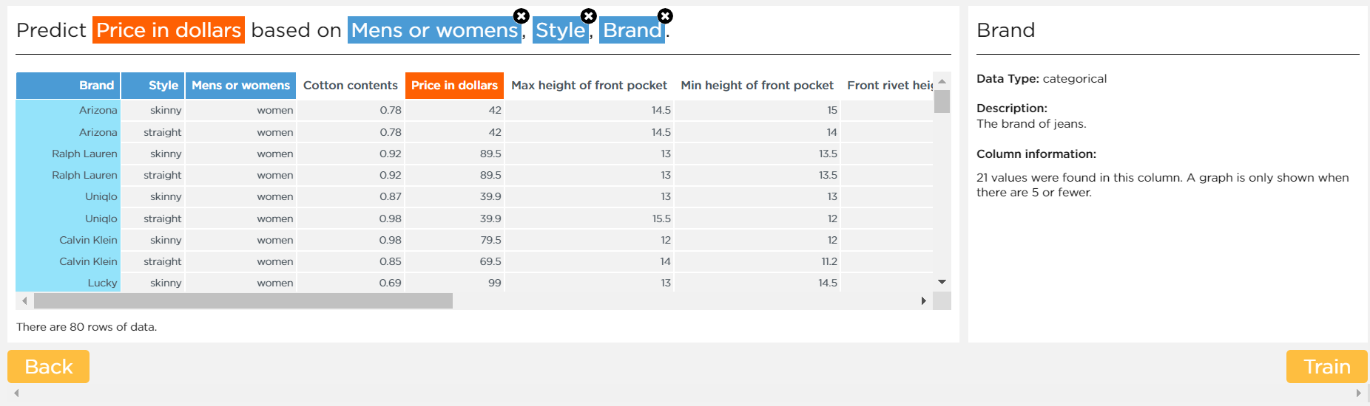
Label of the Feature we want train our predictor model with:
Let’s try Brand, Style, Mens or Womens

Slide 13
Let’s train our model

Slide 14
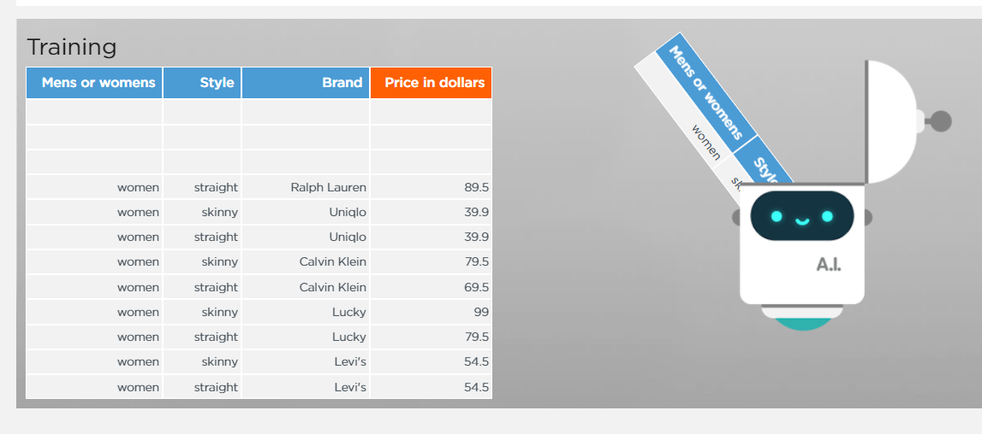
How is our model trained?
Step 1 - Our dataset is first split into two sets by AI lab
Training set (90% of our data)
Test set (10% of our data)
This is a random process so your results may vary based on what data was included in the training or the test set.
Step 2 - A ML algorithm is use to find patterns in the training data. Patterns are statistical relationships called correlations between the value to be predicted and the features selected for the training.
Step 3 - After the training is complete and the model is created, it needs to be tested for accuracy using the test set.

Slide 15
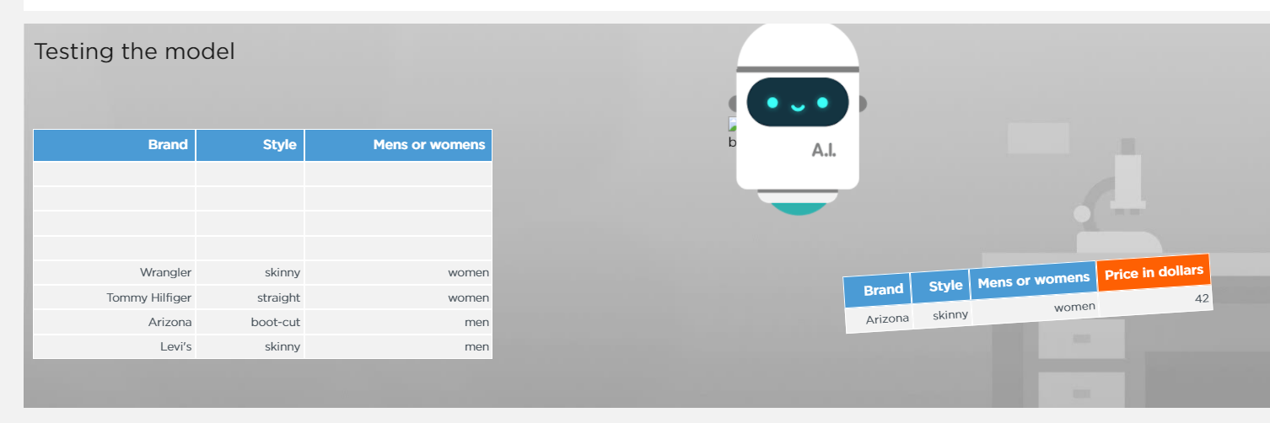
Testing the Model - Press Continue to skip this animation!

Slide 16
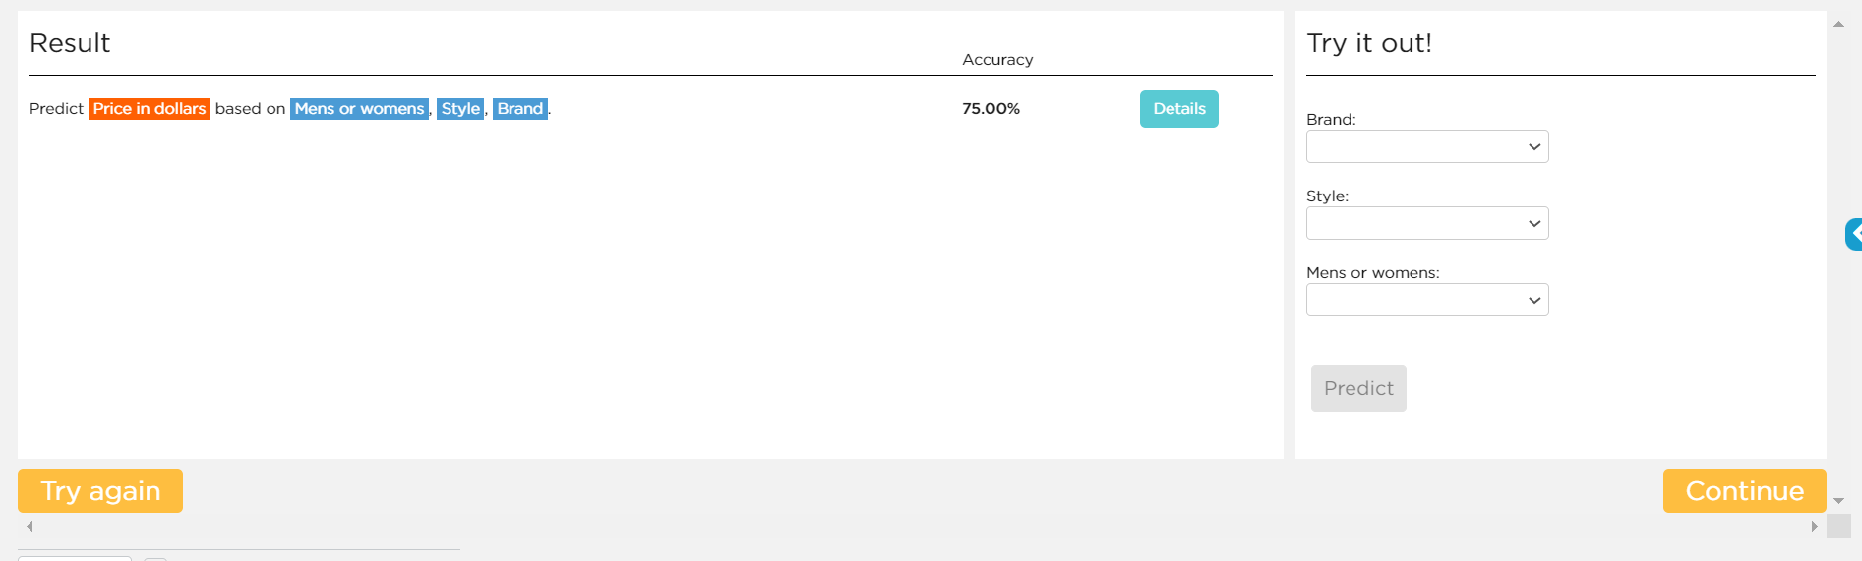
Evaluating the Accuracy of the Model
This selection and test had an accuracy of 75%…Let’s see how well it did.

Slide 17
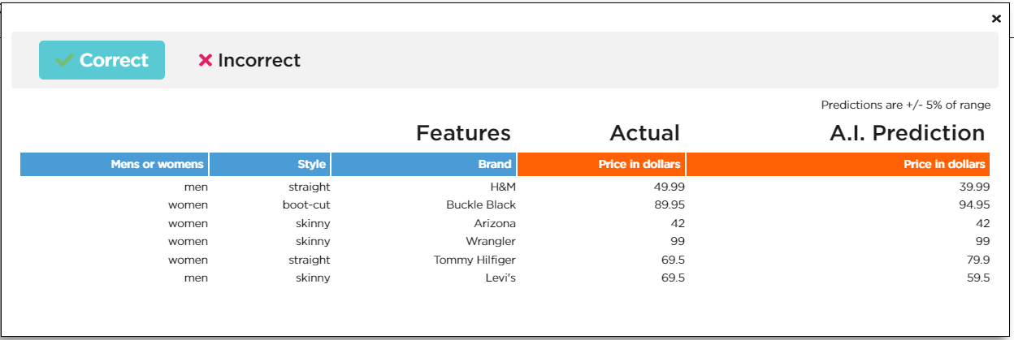
Explore Correct Predictions
Notice that correct - doesn’t mean it has to exactly match. There is a range of +/- 5%.

Slide 18
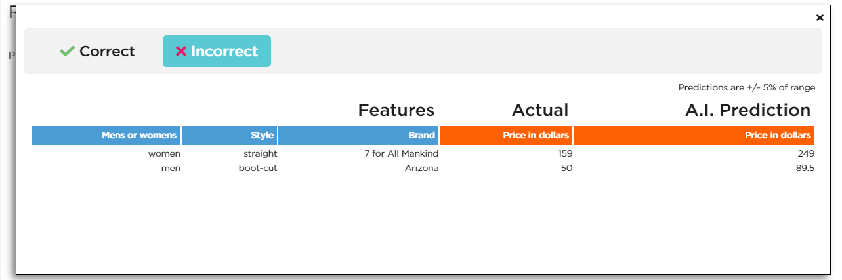
Explore Incorrect Predictions
Wow! Look at very different these predictions are. They are off by way more that +/- 5%

Slide 19
Note - Your results may be different than the slides, even though you picked the same features and data set. Remember, the AI trains with 90% of the data, and tests with the remaining 10%. Which numbers are included in each section can change the result.

Slide 20
Now you try!
Click Try Again in the bottom left corner.
Keep the prediction set to the price of jeans, and select two or three features you think will give the most accurate results. Place your answers in the table below.
 | Feature for category 1 | Category 2 | Category 3 | Percent Correct
Attempt 1 | Brand |  |  | 75
Attempt 2
Attempt 3
Attempt 4
Attempt 5

Slide 21
A solution to the Jeans dataset
  Try these features:
Brand, Cotton Contents, Mens or Womens

